Slide 1
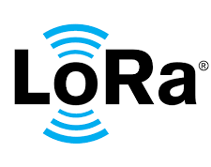
Advanced Topics in Computer Networks Receive and Transmit LoRa packets Koutsoukis Nikolaos 2907

Slide 2
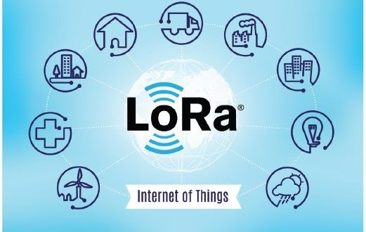
LoRa, created by Semtech, is a communication protocol that uses spread spectrum modulation to enable long-range, low-power wireless communication between devices. LoRa technology is suitable for a wide range of IoT applications, including smart cities, industrial automation, healthcare, logistics, and agriculture. Its long-range and low-power capabilities make it particularly well-suited for IoT devices that require extended battery life and communication over long distances.
WHAT IS LoRa?

Slide 3
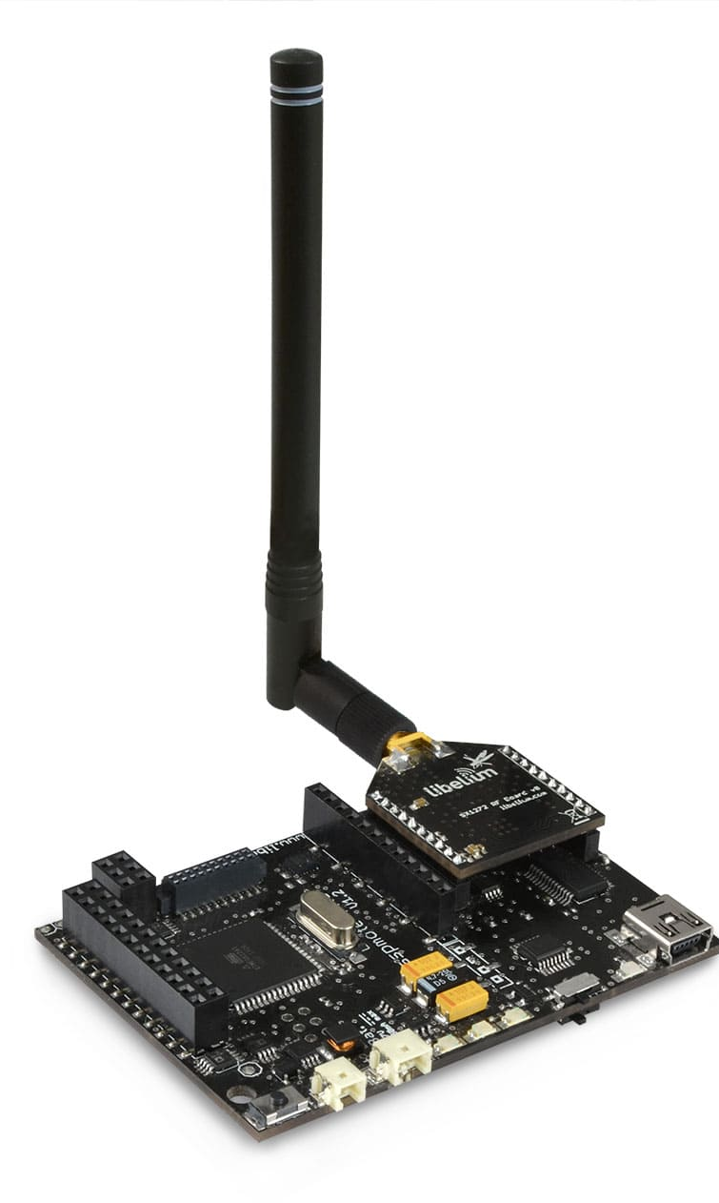
Waspmote board SX1272 module

Slide 4
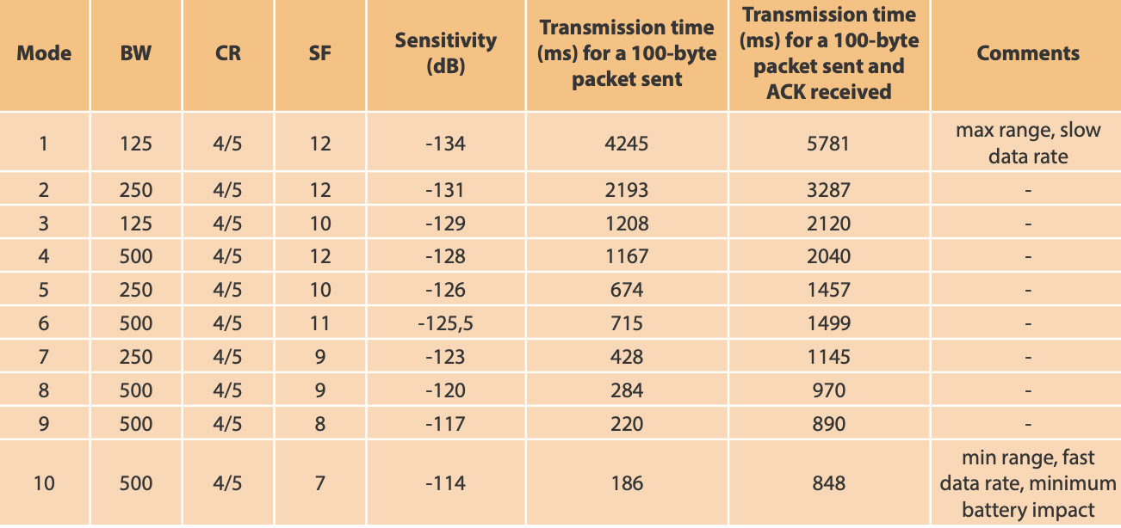
Modes of Lora

Slide 5
For the implementation of the Receiver were used:
Gnu Radio
https://github.com/rpp0/gr-lora

Slide 6
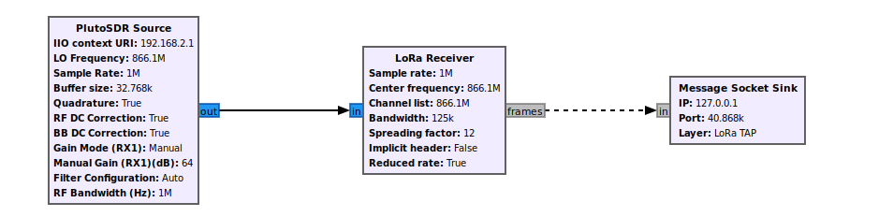
LoRa Receiver

Slide 7
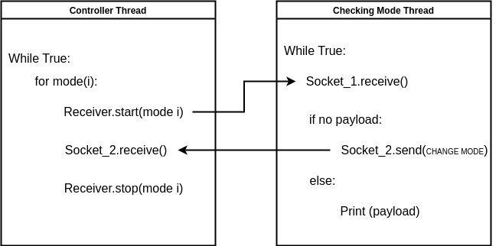
Dynamic LoRa Receiver

Slide 8
For the implementation of the Transmitter were used:
Gnu Radio
https://github.com/tapparelj/gr-lora_sdr

Slide 9
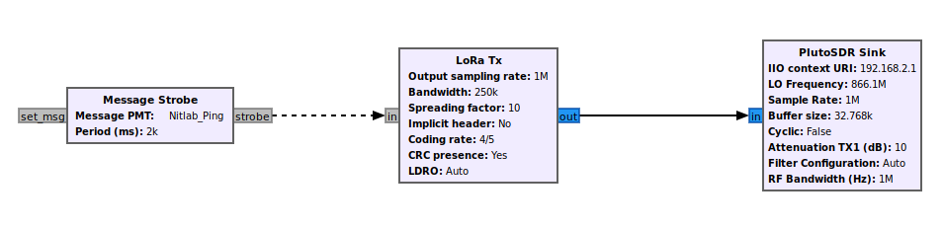
LoRa Transmitter

Slide 10
Demo 1: Dynamic LoRa Receiver

Slide 11
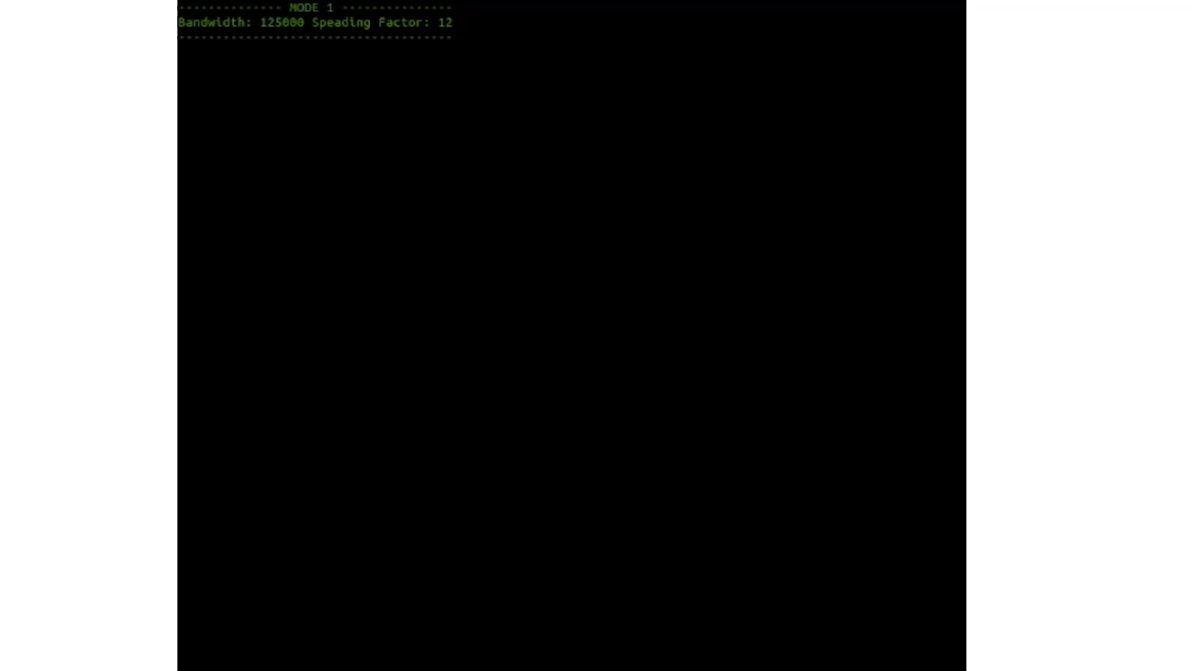

Slide 12
Demo 2: Transmit Receive LoRa Packets

Slide 13
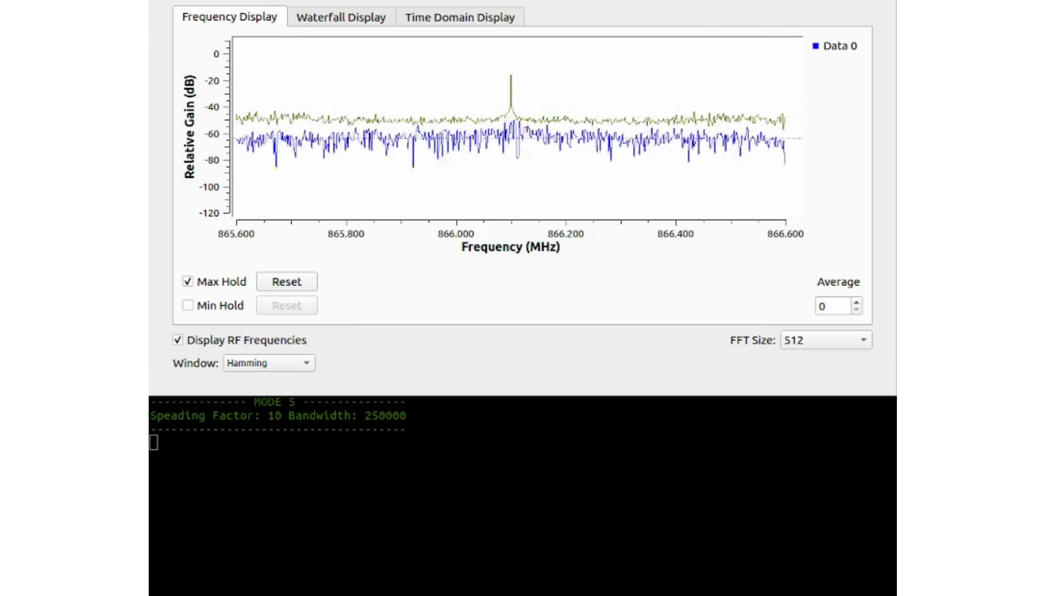

Slide 14
THANK YOU FOR YOUR TIME

